Slide 1
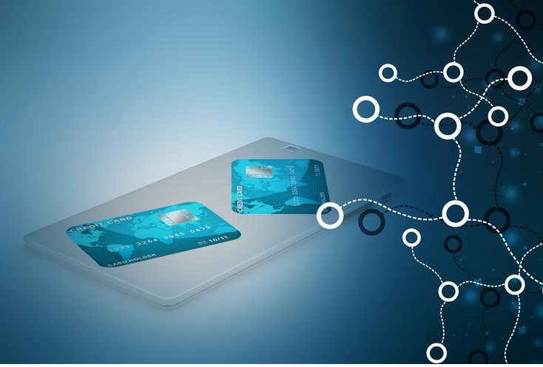
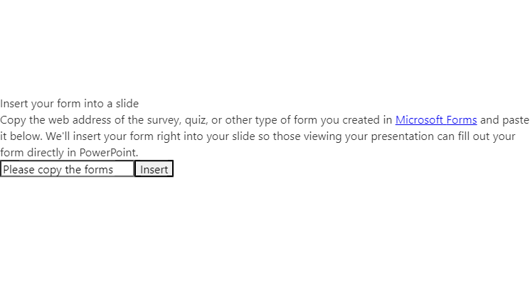
SEIS 763 : Machine Learning Project : Credit Card Fraud Detection Professor: Dr. Chih Lai
Team Member:
Duyen Su
Yeeyin Lim
Priyanka Patil
Pragya Verma
Mugdha Dixit

Slide 2
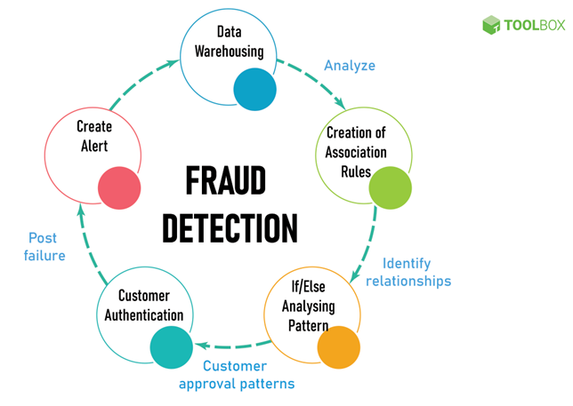
Overview:
Financial Security Imperative
Rise of Machine Learning in Fraud Prevention
Effective Models for Credit Card Fraud Detection
Notes:
Financial Security Imperative:
Explanation: In the domain of financial security, adapting to ongoing changes is crucial, requiring a specific emphasis on identifying and preventing fraudulent activities in credit card transactions—essential not only for regulatory compliance but also for maintaining the financial well-being of banks by retaining profitable customers and preventing substantial monetary losses.
Rise of Machine Learning in Fraud Prevention:
Explanation: The banking sector is turning to machine learning for a proactive approach, enabling real-time transaction monitoring to swiftly detect anomalies and potential fraud instances, while the implementation of advanced fraud prevention mechanisms, driven by machine learning algorithms, ensures staying ahead of constantly evolving fraud tactics.
Effective Models for Credit Card Fraud Detection:
Explanation: The focus is on building robust machine learning models to detect and prevent credit card fraud by going beyond traditional rules, utilizing machine learning to adapt to new patterns, and ensuring security through real-time monitoring in order to swiftly identify and mitigate the threat of banking fraud

Slide 3

Problem Statement:
Highlighting the vital importance of banks identifying and preventing fraudulent credit card transactions
Creating The models for detecting the fraud transactions.
Exploring different machine learning model learning.
Highlighting how machine learning enables proactive monitoring and efficient fraud prevention, reducing manual reviews.
Notes:
Expanation:.

Slide 4

Understanding Data
Data Sourcing:
Data URL : https://www.kaggle.com/datasets/mlg-ulb/creditcardfraud

Slide 5

Data Mining
﻿
Defining the Business Problem
Exploring Data Understanding
Preparing the Data
Implementing Model
Model Evaluation
Notes:
Explanation:
Defining the Business Problem: The initial phase involves a thorough comprehension of the problem description, outlining crucial questions that need resolution.
Exploring Data Understanding: Comprehensive univariate and bivariate analyses are conducted to unravel relationships between dependent and independent variables, providing a profound insight into the dataset.
Preparing the Data: This stage involves readying the dataset for data mining techniques. Conventional pre-processing methods, including variable transformation, data splitting, and cleaning, are applied to ensure optimal usability.
Implementing Models: Data mining techniques are employed to predict insurance charges for each patient. Multiple algorithms are executed, evaluated, and compared to identify the most effective model.
Model Evaluation: The final stage rigorously assesses and compares each model using a test set. The selection criterion is based on performance metrics such as RMSE (Root Mean Square Error) and Adjusted R-Square, ensuring the identification of the most robust model.

Slide 6
Data Description
﻿
The data set includes credit card transactions made by European cardholders over a period of two days in September 2013.
There are 31 columns and 284807 rows.
Information about transactions.
Notes:
The feature 'time' contains the seconds elapsed between the first transaction in the data set and the subsequent transactions.
The feature 'amount' is the transaction amount.

Slide 7

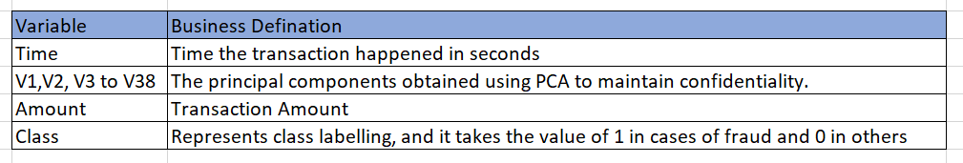
Data Statistics
Apart from 'time’, 'amount’ & ‘class’, all the other features (V1, V2, V3, up to V28) are the principal components obtained using PCA to maintain confidentiality.
There is no null value in the dataset.
The feature 'class' represents class labelling, and it takes the value of 1 in cases of fraud and 0 in others.

Slide 8
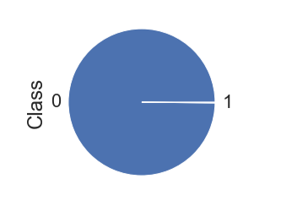
Data Statistics
Out of 284807, Non Fraud Transactions are 284315 and Fraud Transactions are 492.
This data set is highly unbalanced, with class1 (frauds) accounting for 0.172% and class 0 (not fraud) 99.82% of all the transaction

Slide 9
SMOTE
We applied SMOTE (Synthetic Minority Over-sampling Technique) to address the high imbalance in the dataset. This technique involves generating synthetic samples for the minority class to achieve a more balanced representation and improve the model's performance.

Slide 10
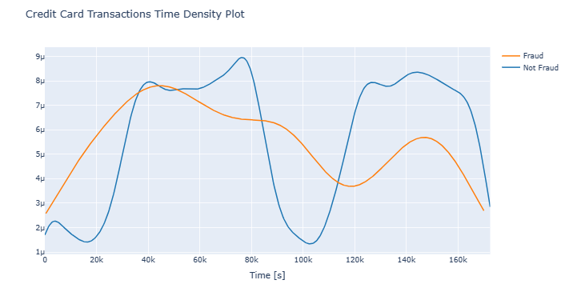
Exploratory Data Analysis
Uniform Distribution of Fraudulent Transactions:
Inclusiveness of Low Transaction Times
Notes:
Fraudulent transactions have a distribution more even than valid transactions - are equally distributed in time, including the low real transaction times, during night in Europe time zone

Slide 11
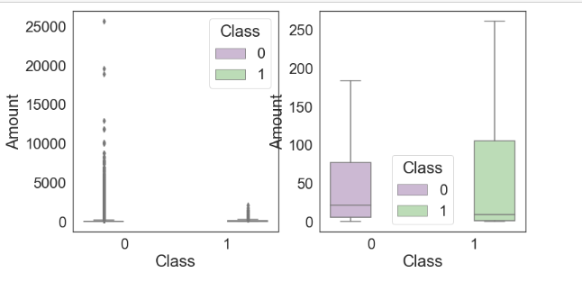
Credit card amount vs class
Typical fraudulent transaction around 9.25, with the largest being 2125.87.
Regular transactions have a median value of 22, with the largest going up to 25691.
Suggests fraudsters avoid extremely large transactions, possibly to evade security measures or due to a higher frequency of normal transactions.
Notes:
The typical fraudulent transaction is around 9.25, with the biggest one being 2125.87. On the other hand, regular transactions usually have a median value of 22, but the largest one can go up to 25691. This difference suggests that fraudsters might stay away from extremely large transactions, possibly to avoid triggering security measures. Another possibility is that there are just more normal transactions overall.

Slide 12
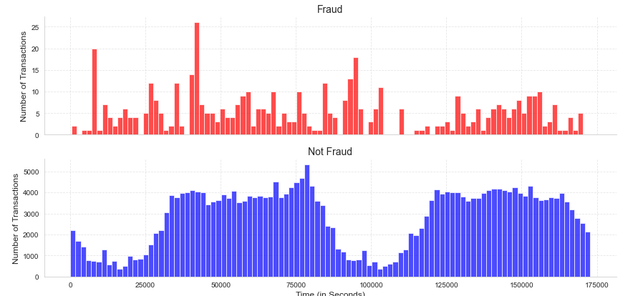
Distribution of transactions in Fraud& Not Fraud Transactions
Red bars: Fraudulent transactions, less frequent, shorter in height.
Peaks: Fraud may occur in bursts or specific moments, not evenly distributed.
Blue bars: Normal transactions, more numerous, steady cycle, increased activity during mornings and evenings.
Notes:
The red bars on the graph show fraudulent transactions. Imagine the x-axis as a timeline in seconds and the y-axis as the number of transactions. Fraudulent ones happen less often than normal transactions, which you can see because the red bars are shorter. Also, there are peaks at specific times, hinting that fraud might happen in bursts or at certain moments instead of being spread out evenly.Now, look at the blue bars for normal transactions – they have more bars, meaning there are more of them. The pattern is steady, like a repeating cycle. It seems like there are times when a lot of transactions happen, like in the mornings and evenings when people often use their credit cards.

Slide 13
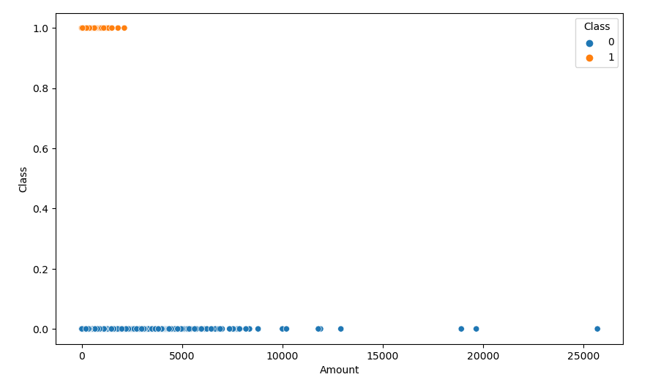
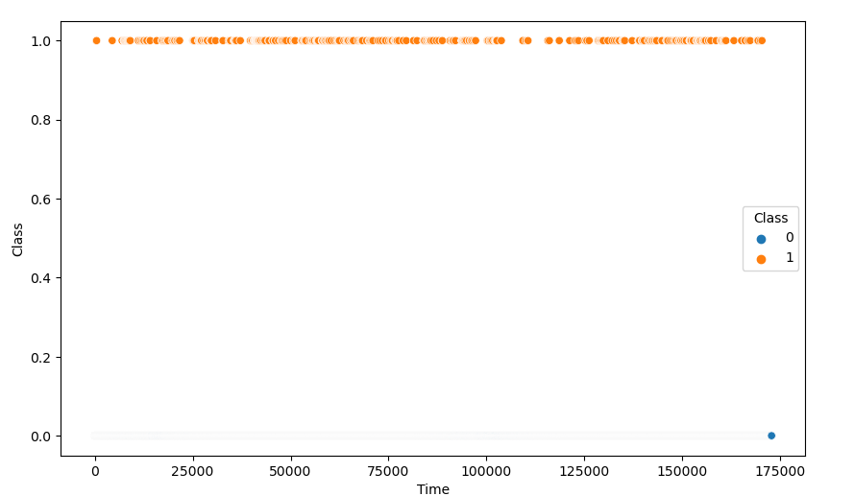
Checking the effect of Amount and Time columns of the dataset on Class
Amount
Time

Slide 14
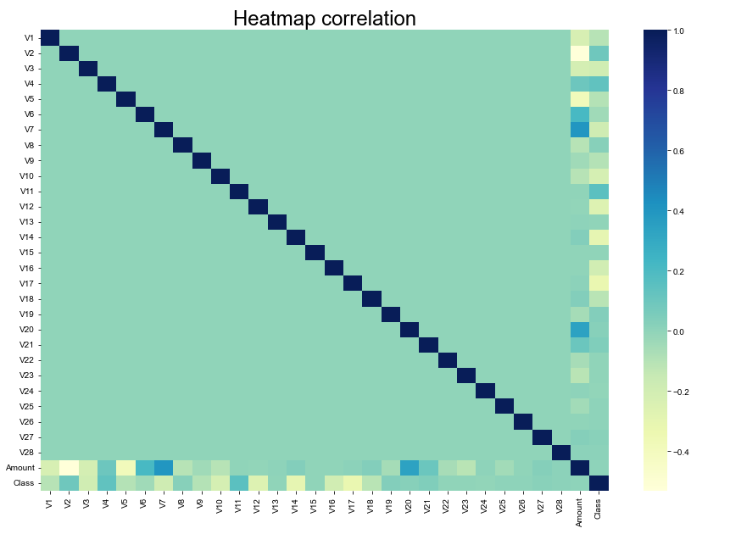
Distribution of various features of our dataset

Slide 15
Training Data and Test Data Reframing
Training size : 60%
Testing size : 40%
We chose this partition size to accommodate the substantial amount of data, especially considering the application of SMOTE for handling class imbalance.
X_train - (170884, 29)
y_train - (170884,)
X_train_smote - (341160, 29)
y_train_smote - (341160,)
X_test - (113923, 29)
y_test - (113923,)

Slide 16
Model Names
Logistic Regression (with and without SMOTE)
Decision Tree (with and without SMOTE)
K Nearest Neighbors (with and without SMOTE)
Random Forest Classifier (with and without SMOTE)
Support Vector (with and without SMOTE)
We're evaluating five distinct methods on both the original training set and an engineered data training set to comprehensively compare how imbalanced data influences performance across these diverse models. These created 10 different models for both with and without synthetic data.

Slide 17


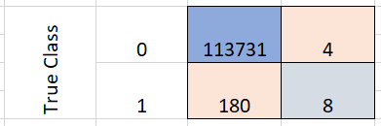
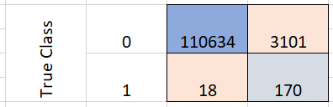
Model Comparisons & Matrix : Logistic Regression
Without Synthetic Data
With Synthetic Data
Confusion Matrix
Confusion Matrix

Slide 18




Model Comparisons & Matrix : Decision Tree
Without Synthetic Data
With Synthetic Data
Confusion Matrix
Confusion Matrix

Slide 19




Model Comparisons & Matrix : K Nearest Neighbors
Without Synthetic Data
With Synthetic Data
Confusion Matrix
Confusion Matrix

Slide 20




Model Comparisons & Matrix : Random Forest
Without Synthetic Data
With Synthetic Data
Confusion Matrix
Confusion Matrix

Slide 21




Model Comparisons & Matrix : Support Vector Machine
Without Synthetic Data
With Synthetic Data
Confusion Matrix
Confusion Matrix

Slide 22
Comparing precision, accuracy f1 score and recall of all the models
Model Name | Result
Logistic Regression without Synthetic data | 0.998385
Logistic Regression with Synthetic data | 0.972622
Decision Tree without Synthetic data | 0.998367
Decision Tree with Synthetic data | 0.972754
KNN without Synthetic data | 0.99849
KNN with Synthetic data | 0.997393
Random Forest without Synthetic data | 0.99835
Random Forest with Synthetic data | 0.994689
SVM without Synthetic data | 0.998367
SVM with Synthetic data | 0.998367

Slide 23

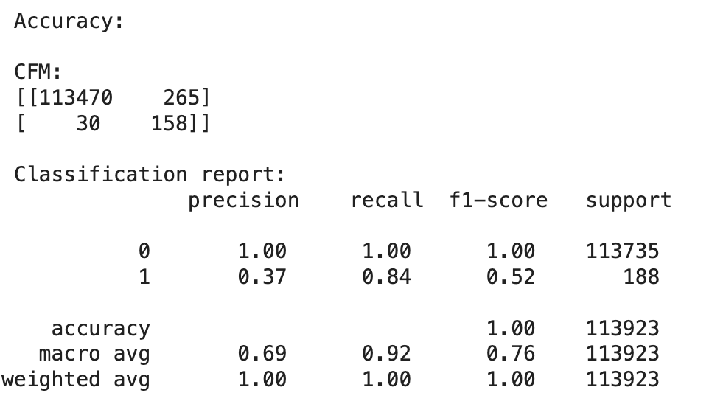
Conclusions
In Summary, we found that K-Nearest Neighbors (KNN) model outperforms other models surprisingly.
SMOTE has demonstrated to improve the performances when handling the unbalanced data.

Slide 24


Slide 25
Thank You

